Slide 1
CS348 Project Stage 2
Jiaxun Li
03/29/2025

Slide 2
Database Design
User(id, email, password, first_name)
Note(id, data, date, last_modified, user_id)
Tag(id, name, user_id)
note_tags(note_id, tag_id) this is a many-to-many relationship
Note: Bold and underscored attributes are the primary key for the relation. Blue attributes are foreign key(s) in that relation.

Slide 3
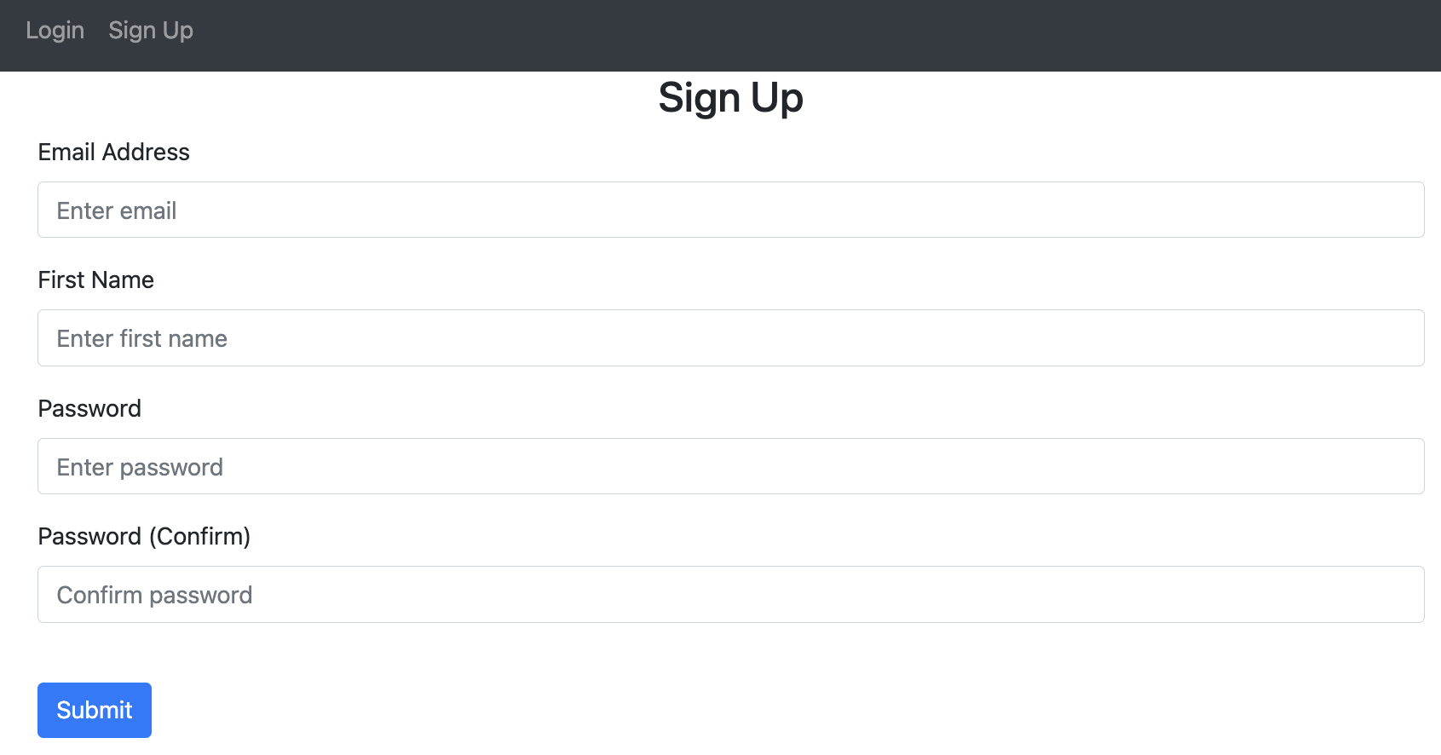
User Interface: Sign Up

Slide 4
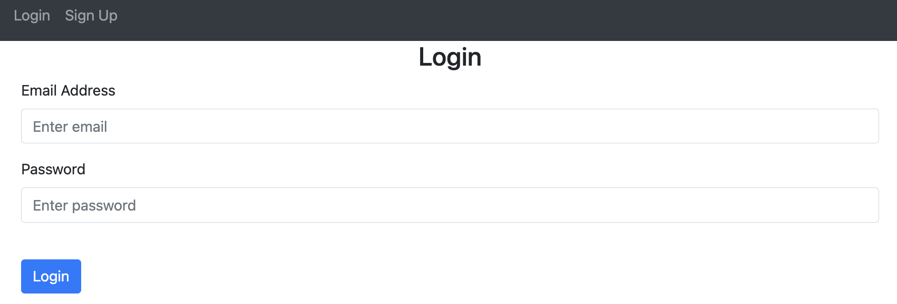
User Interface: Login

Slide 5
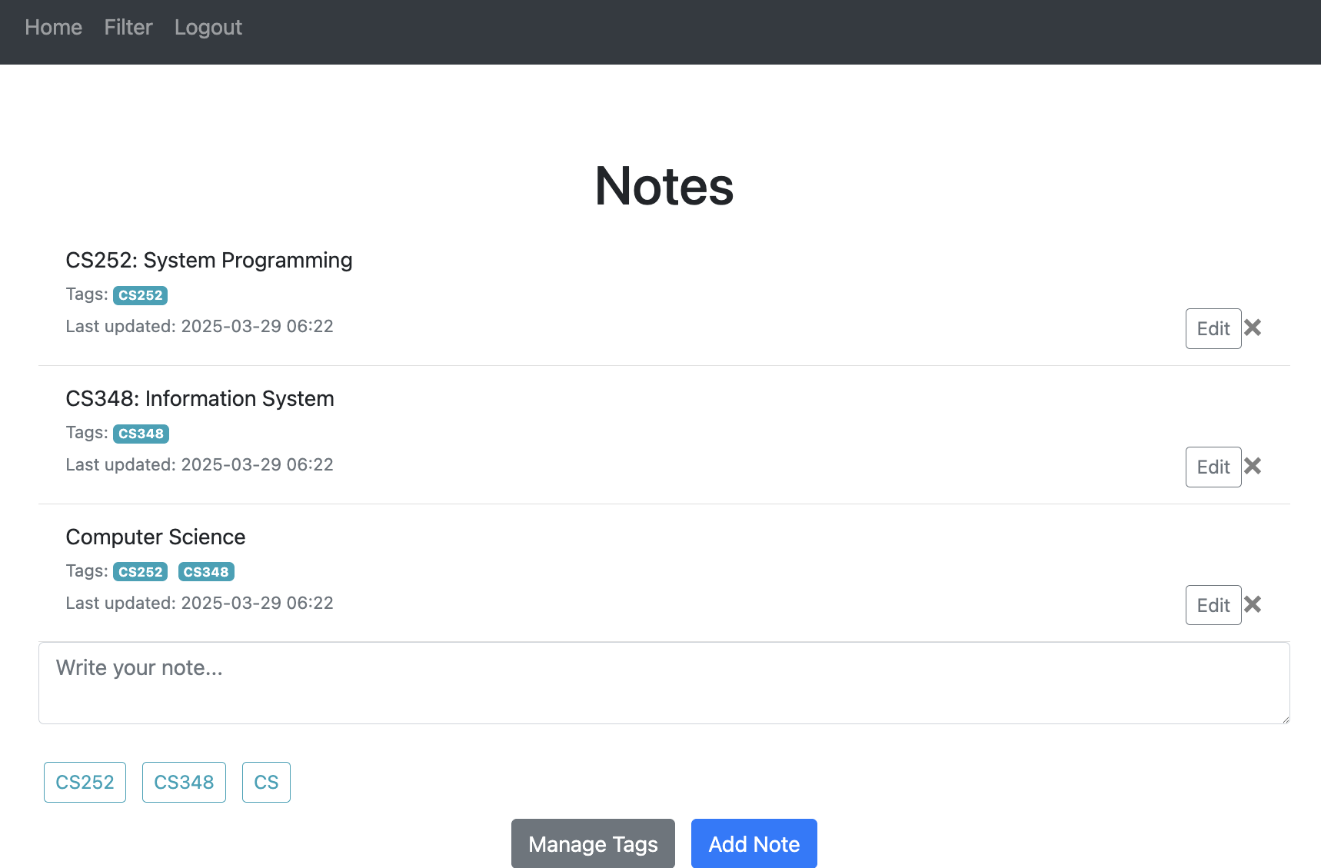
User Interface: Home Page

Slide 6
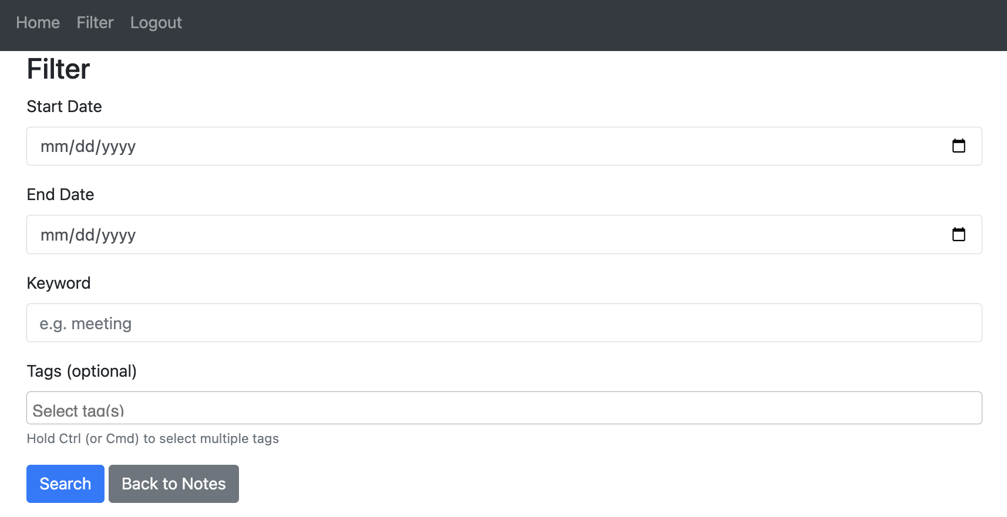
User Interface: Filter

Slide 7
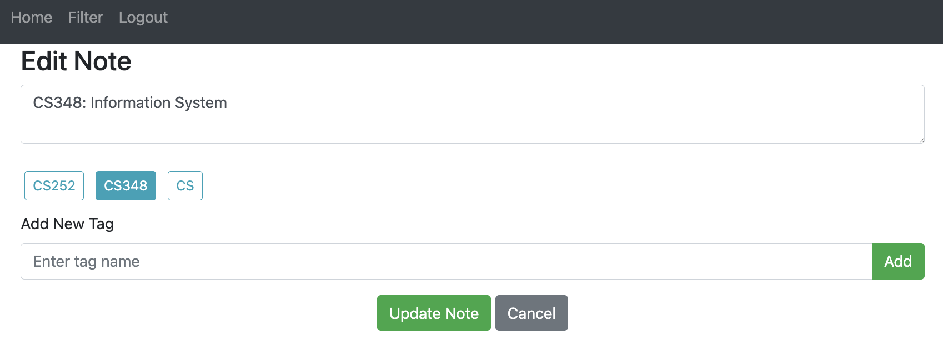
User Interface: Edit Note

Slide 8

User Interface: Log Out
After clicking Logout, it will go back to Login page and the user can log in again.

